Slide 1
House Sales in King County
Instructor： Khasha Dehnad
Team member： Heran Zhu
Zhibo Yang

Slide 2
Outline
Background
Introduction to Data
Data Analysing
Conclusion

Slide 3
Background
Business importance
This data set including home sale between May 2014 to May 2015 and house sale price.
House sale price is determined by different kinds of attributes, like the number of bedroom and bathroom, floors, area, and etc.
It will be helpful to design an efficient and convenience model to help to predict house sale price.
Objective
Find the relationship between price and attributes.

Slide 4
Outline
Background
Introduction to Data
Data Analysing
Conclusion

Slide 5
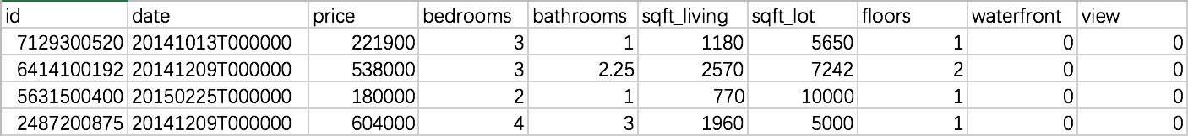
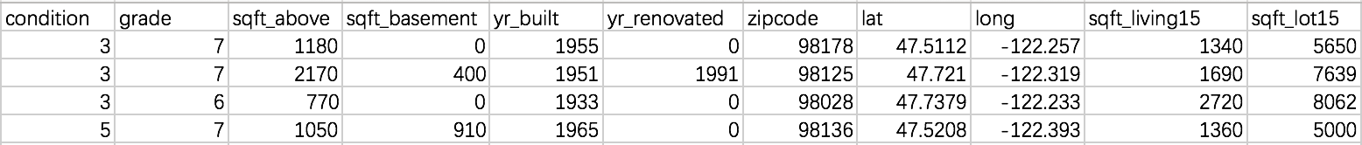
Introduction to Data
Variables:
21613 observations and 15 features plus id and price columns
6 continuous features and 9 categorical features
Sample data:

Slide 6
Introduction to Data(Cont’)
Variable | Description
id | Unique ID for each home sold
date | Date of the home sale
price | Price of each home sold
bedrooms/bathrooms | Number of bedrooms/bathrooms，where .5 accounts for a room with a toilet but no shower.
sqft_living | Square footage of the apartments interior living space.
sqft_lot | Square footage of the land space
floors | Number of floors
waterfrount | A dummy variable for whether the apartment was overlooking the waterfront or not.
view | An index from 0 to 4 of how good the view of the property was.
condition | An index from 1 to 5 on the condition of the apartment.
Variable | Description
grade | 1-3 falls short of building construction and design, 7 has an average level of construction and design, and 11-13 have a high quality level of construction and design.
sqft_above | The square footage of the interior housing space that is above ground level
sqft_basement | The square footage of the interior housing space that is below ground level
yr_built | The year the house was initially built
yr_renovated | The year of the house’s last renovation
zipcode | What zipcode area the house is in
lat | Lattitude
long | longitude
sqft_living15 | The square footage of interior housing living space for the nearest 15 neighbors
sqft_lot15 | The square footage of the land lots of the nearest 15 neighbors

Slide 7
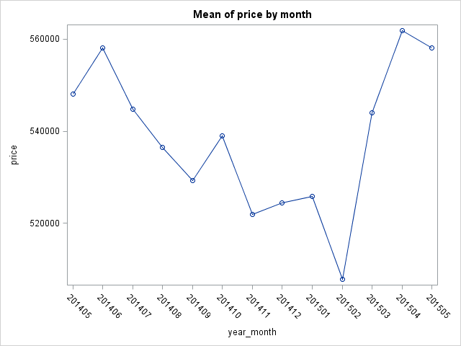
Introduction to Data(Cont’)
Visualization: mean of price by month

Slide 8
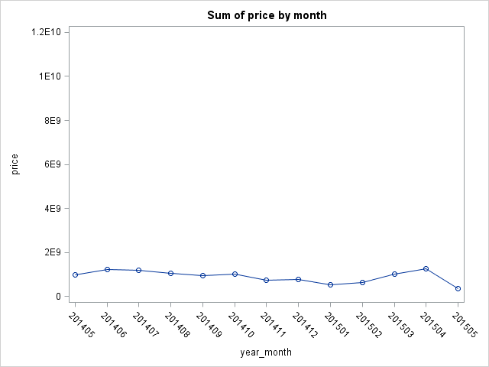
Visualization: Sum of price by month

Slide 9
Outline
Background
Introduction to Data
Data Analysis
Conclusion

Slide 10
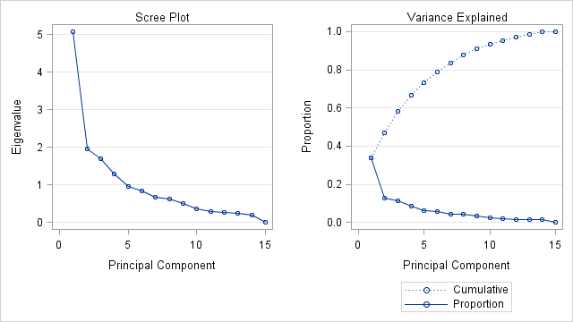
Principal Component Analysis

Slide 11
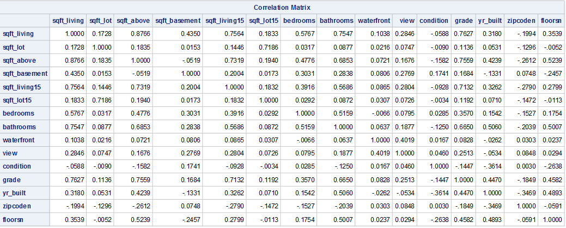

Slide 12
Linear Regression
Simple Linear Regression
Multiple Regression

Slide 13
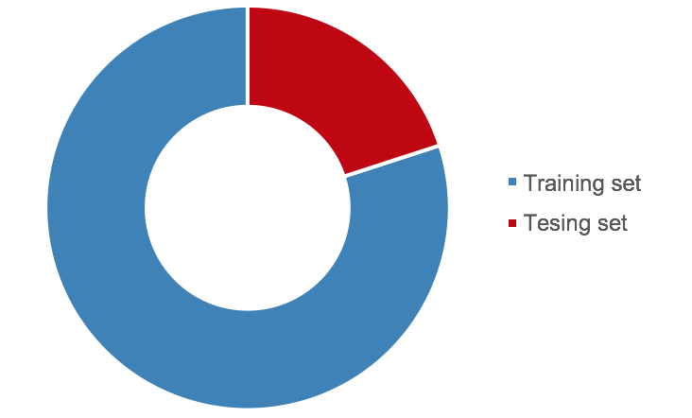
Data Preprocessing
Split Data(Ramdomly)
80% Training
20% Testing

Slide 14
Data Preprocessing
Create dummy variables
view | view_0 | view_1 | view_2 | view_3 | view_4 | Frequency | Percent | Cumulative Frequency | Cumulative Percent
0 | 1 | 0 | 0 | 0 | 0 | 15595 | 90.19 | 15595 | 90.19
1 | 0 | 1 | 0 | 0 | 0 | 261 | 1.51 | 15856 | 91.70
2 | 0 | 0 | 1 | 0 | 0 | 776 | 4.49 | 16632 | 96.19
3 | 0 | 0 | 0 | 1 | 0 | 400 | 2.31 | 17032 | 98.50
4 | 0 | 0 | 0 | 0 | 1 | 259 | 1.50 | 17291 | 100.00

Slide 15
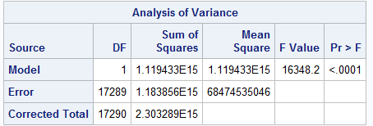
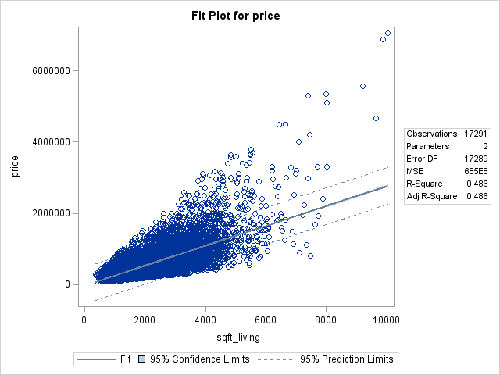
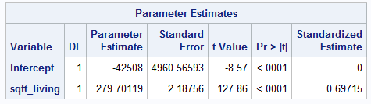
Simple Linear Regression

Slide 16
Training
Estimator | RootMSE | R-Square | Intercept | Coefficient | STD-Coef
bedrooms | 349246 | 0.0951 | 129802 | 121716 | 0.30835
bathrooms | 312439 | 0.2758 | 10708 | 250327 | 0.52514
sqft_living | 261453 | 0.4929 | -43581 | 280.62357 | 0.70204
waterfront | 351534 | 0.0724 | 529894 | 1132612 | 0.26909
view_0 | 342645 | 0.1290 | 939447 | -442883 | -0.35912
grade_10 | 345158 | 0.1161 | 510647 | 561124 | 0.34080
grade_11 | 342885 | 0.1277 | 522093 | 974749 | 0.35741
sqft_above | 292164 | 0.3667 | 59953 | 268.47319 | 0.60557
sqft_basement | 347354 | 0.1049 | 461785 | 268.61358 | 0.32382
sqft_living15 | 297659 | 0.3427 | -82807 | 313.55594 | 0.58538

Slide 17
Testing
Estimator | Training RMSE | Test RMSE
Bedrooms | 349246 | 358539.21041
Bathrooms | 312439 | 314059.02482
Sqft_living | 261453 | 260546.02813
waterfront | 351534 | 363088.52203
View_0 | 342645 | 345016.77181
Grade_10 | 345158 | 353746.48811
Grade_11 | 342885 | 343434.60291
Sqft_above | 292164 | 293460.34796
Sqft_basement | 347354 | 352719.28242
Sqft_living15 | 297659 | 263340.07995

Slide 18
Multiple Regression
Variables: zipcode of top 10 frequency
year built (group by decades)
all other variables

Slide 19
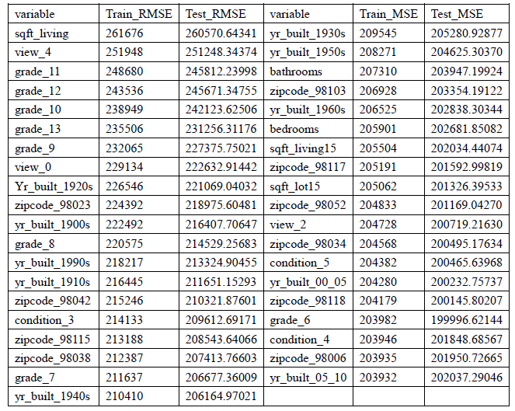

Slide 20
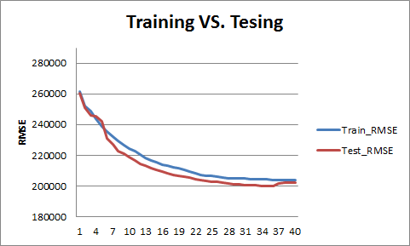

Slide 21
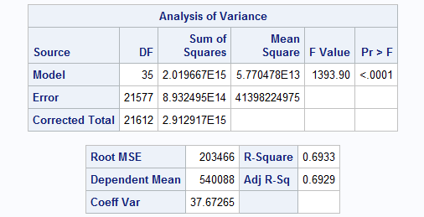
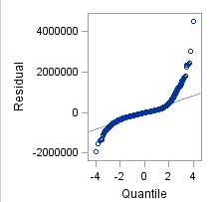

Slide 22
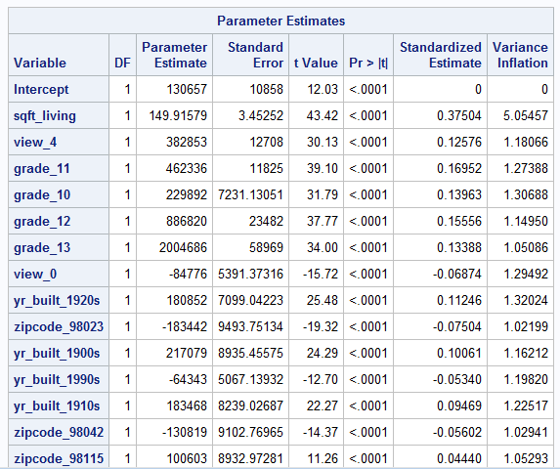

Slide 23
Model: Logistic Regression
Target Value: Numerical to Categorical
price = 0 if less than 300000
= 1 if less than 600000 and more than 300000
= 2 if larger than 600000

Slide 24
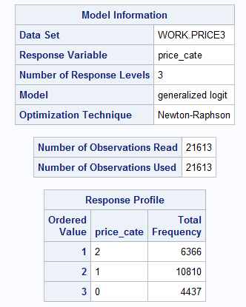
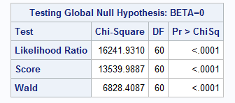

Slide 25
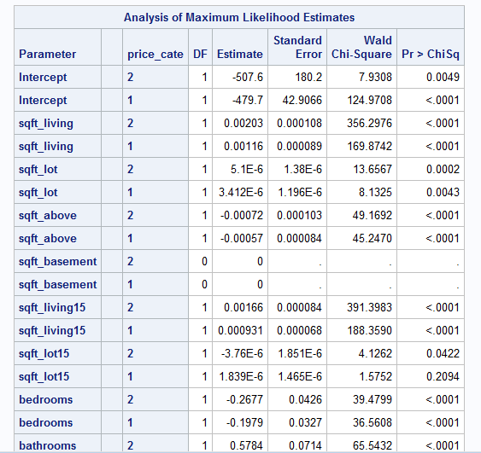
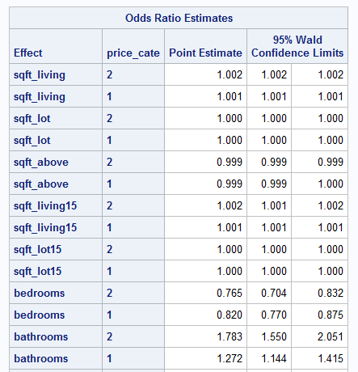

Slide 26
Model: Neural Network
Python sklearn package

Slide 27
x1
h21
h11
h31
x2
h22
h12
h32
y
x3
h23
h13
h33
x4
h24
……
……
……
……
h1j
h3i
xn
h2k

Slide 28
Model | Training Correct Rate | Testing Correct Rate
Logistic Regression | 75.6043% | 75.3874%
Neural Network | 92.7365% | 83.2986%

Slide 29
Outline
Background
Introduction to Data
Data Analysing
Conclusion

Slide 30
Conclusion
Hard to predict price but relatively easier to predict the price range
Adding variables will not always increase the accuracy

Slide 31
Thank you

